Slide 1
LINEAR ALGEBRA
Image Compression using SVD
Group 8
Ahmad Waleed Akhtar BSCE22003
Muhammad Arham BSCE22007
Hadia Ahmad BSCE22017

Slide 2
Singular Value Decomposition
Singular value decomposition (SVD) is a method of representing a matrix as a series of linear approximations that expose the underlying meaning-structure of the matrix. The goal of SVD is to find the optimal set of factors that best predict the outcome.
SVD has a number of real life applications like image processing, approximation in recommender systems and Principal Component Analysis etc.
Our concern is Image Compression using SVD.

Slide 3
Image Compression using SVD
Our goal was to compress an image using SVD, the procedure of compressing a color image is as follows,
The image is split into it’s 3 color channels Red, Green and Blue.
Using SVD each channel is split into three matrixes U, S and V where S is a diagonal matrix and U and V are orthonormal matrix.
Using Certain number of singular value a new image is created which is not as sharp as the real image but gives all the important information.

Slide 4
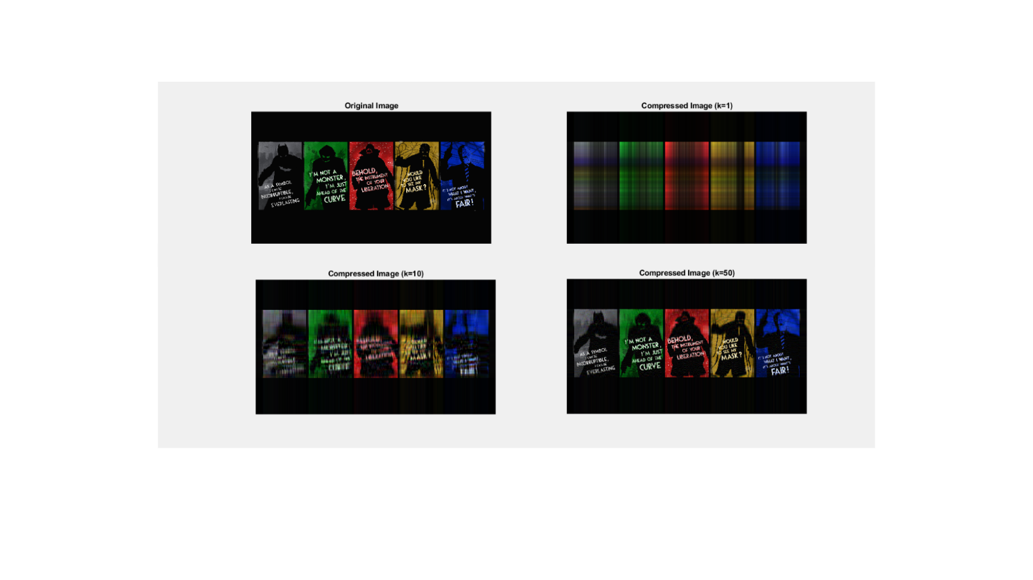
Image Compression using SVD

Slide 5
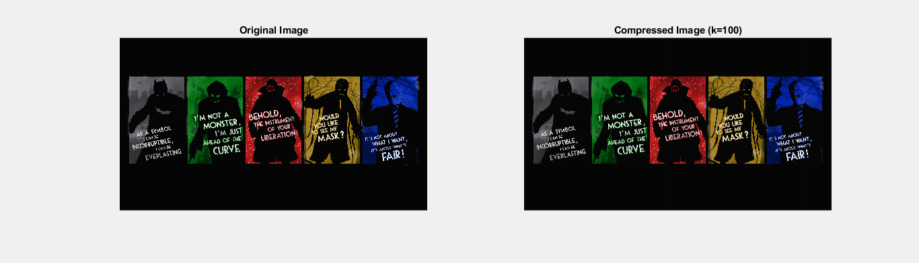
Image Compression using SVD
The image below is almost identical to the original one but on close
inspection we notice that background in original image is sharper and
clearer than compressed image.

